Slide 1


Getting and keeping a job in 10 Minutes or less

Slide 2

Persona

Slide 3
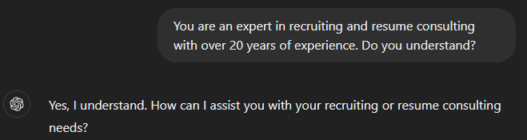
Persona
Notes:
https://platform.openai.com/docs/guides/gpt-best-practices/tactic-ask-the-model-to-adopt-a-persona
https://arxiv.org/pdf/2302.11382.pdf
You are an expert in recruiting and resume consulting with over 20 years of experience. Do you understand?

Slide 4

Resume Advice

Slide 5
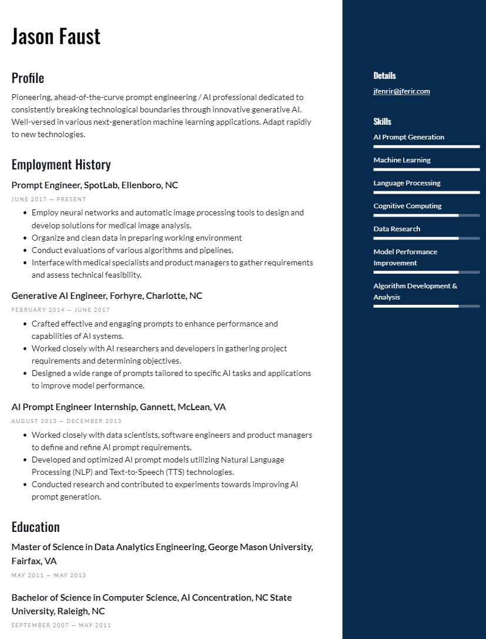
Sample resume

Slide 6
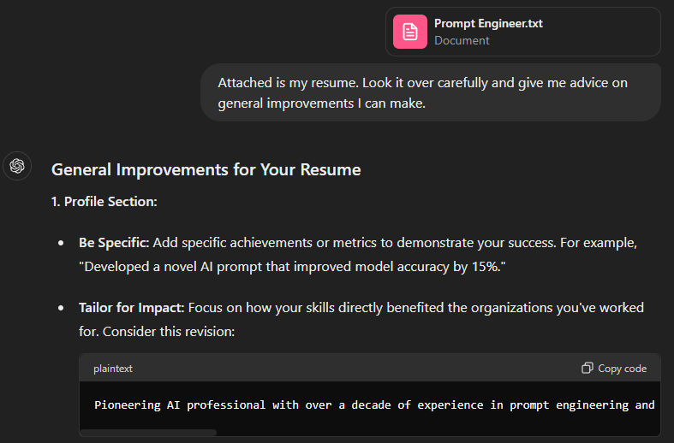
General Resume Advice
Notes:
Attached is my resume. Look it over carefully and give me advice on general improvements I can make.

Slide 7
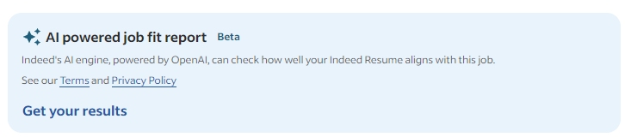
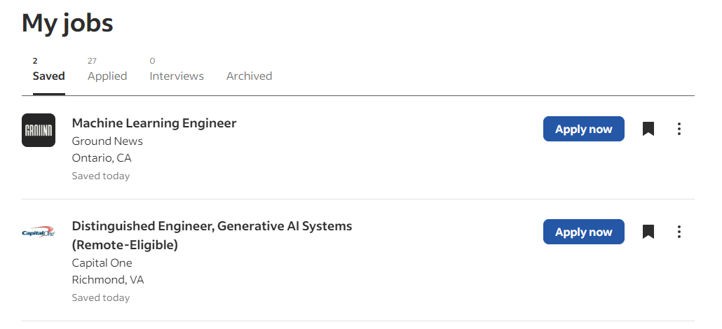
indeed

Slide 8
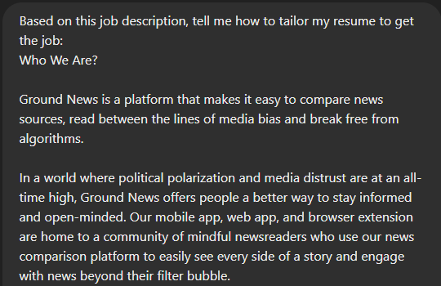
Specific Resume Advice
Notes:
Based on this job description, tell me how to tailor my resume to get the job.

Slide 9

Cover Letters

Slide 10
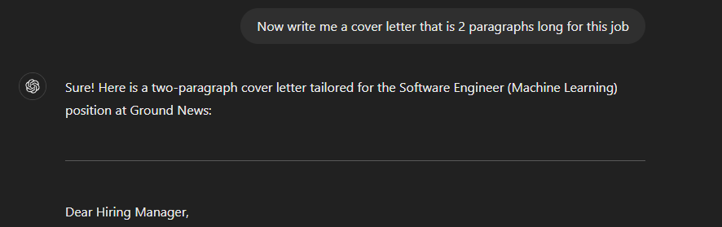
Cover Letters
Notes:
Now write me a cover letter that is 2 paragraphs long for this job

Slide 11

Portfolio Building

Slide 12
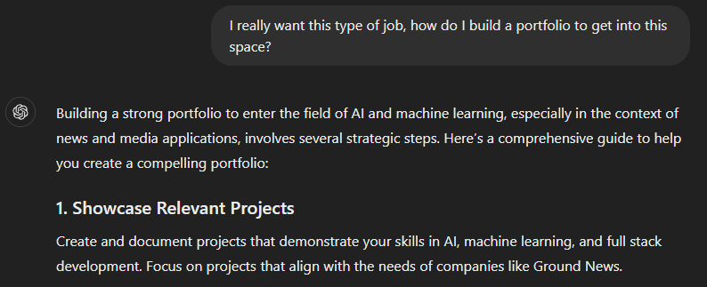
Portfolio Building
Notes:
I really want this type of job, how do I build a portfolio to get into this space?

Slide 13

Interview Prep

Slide 14
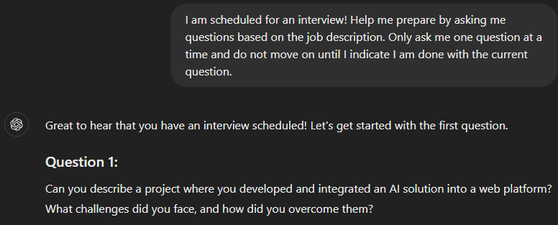
Interview Prep
Notes:
I am scheduled for an interview! Help me prepare by asking me questions based on the job description. Only ask me one question at a time and do not move on until I indicate I am done with the current question.

Slide 15




Notes:
https://www.youtube.com/channel/UC35ZpwldGw7ZJ5R-2sLijzw

Slide 16

On The Job

Slide 17
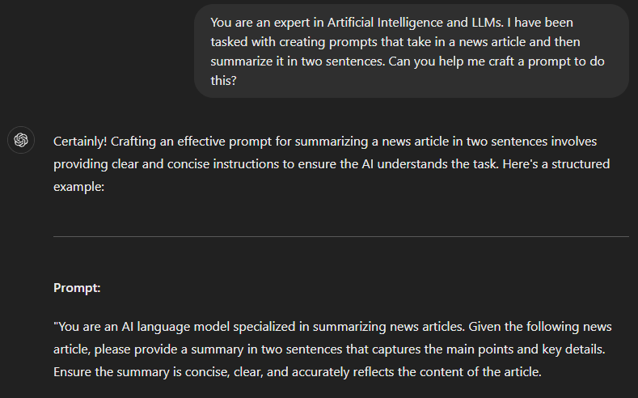
On the Job
Notes:
You are an expert in Artificial Intelligence and LLMs. I have been tasked with creating prompts that take in a news article and then summarize it in two sentences. Can you help me craft a prompt to do this?

Slide 18

Understanding Difficult Concepts

Slide 19
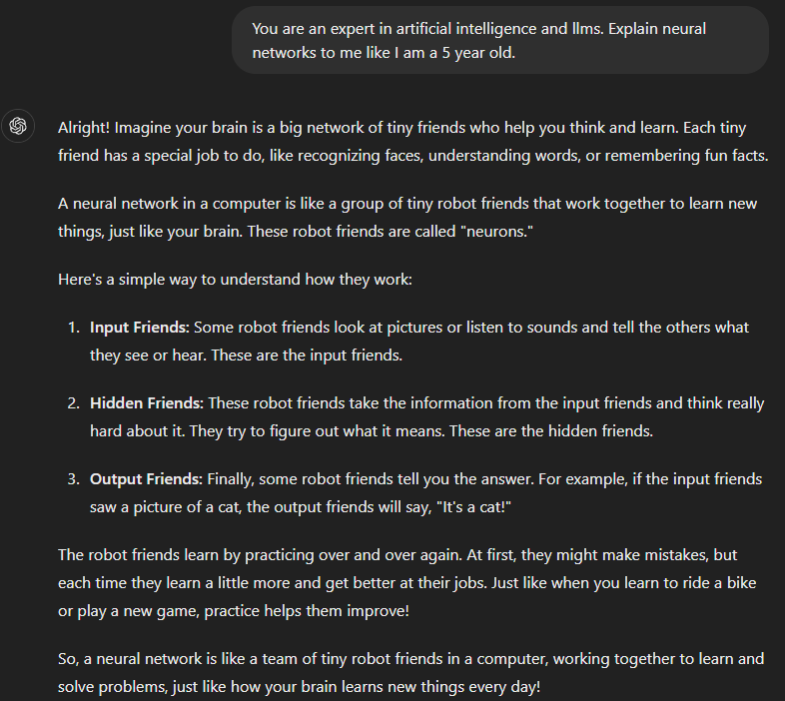
Understanding Difficult Concepts
Notes:
You are an expert in artificial intelligence and llms. Explain neural networks to me like I am a 5 year old.
You are an expert in artificial intelligence and llms. Explain neural networks to me like I am 10 years old.
You are an expert in artificial intelligence and llms. Explain neural networks to me like I am a 17 years old.

Slide 20
